Slide 1
IPv6 ACLs

Slide 2
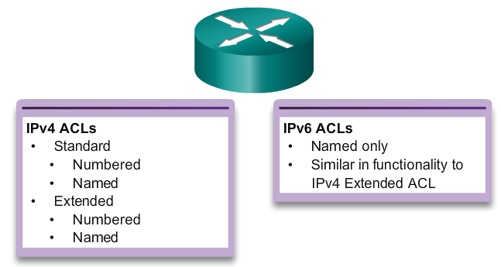
Type of IPv6 ACLs
Notes:
9.5.1.1 Type of IPv6 ACLs

Slide 3
Comparing IPv4 and IPv6 ACLs
Although IPv4 and IPv6 ACLs are very similar, there are three significant differences between them.
Applying an IPv6 ACL
IPv6 uses the ipv6 traffic-filter command to perform the same function for IPv6 interfaces.
No Wildcard Masks
The prefix-length is used to indicate how much of an IPv6 source or destination address should be matched.
Notes:
9.5.1.2 Comparing IPv4 and IPv6 ACLs

Slide 4
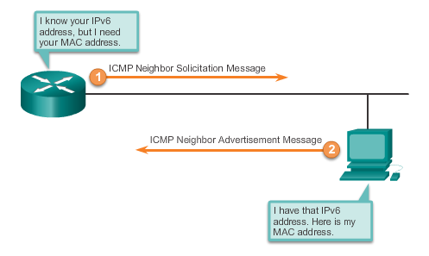
Comparing IPv4 and IPv6 ACLs
Additional Default Statements along with implicit deny
permit icmp any any nd-na
permit icmp any any nd-ns

Slide 5
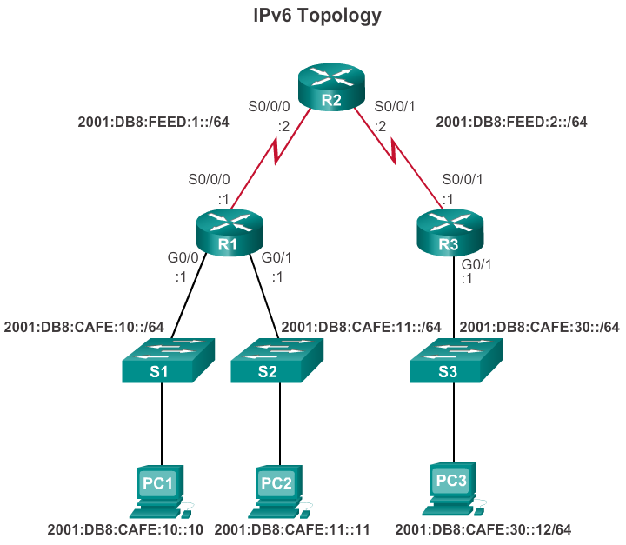
Configuring IPv6 Topology
Notes:
9.5.2.1 Configuring IPv6 Topology

Slide 6
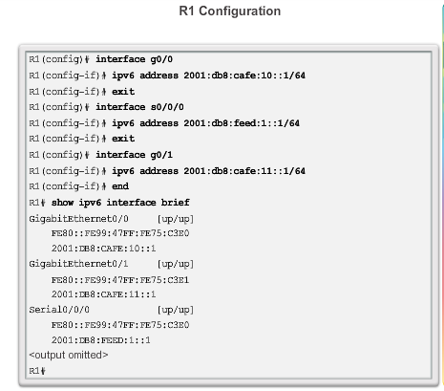
Router R1 Configuration

Slide 7
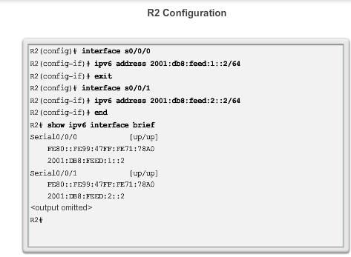
Router R2 Configuration

Slide 8
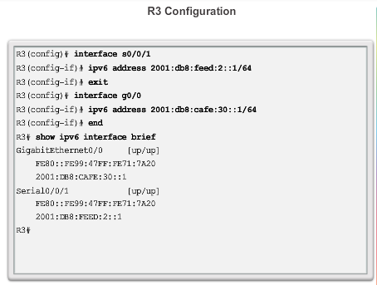
Router R3 Configuration

Slide 9
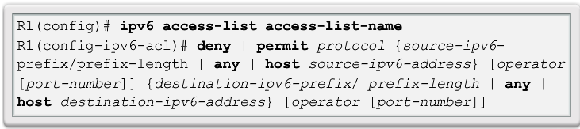
Configuring IPv6 ACLs
There are three basic steps to configure an IPv6 ACL:
From global configuration mode, use the ipv6 access-list name command to create an IPv6 ACL.
From the named ACL configuration mode, use the permit or deny statements to specify one or more conditions to determine if a packet is forwarded or dropped.
Return to privileged EXEC mode with the end command.
Notes:
9.5.2.2 Configuring IPv6 ACLs

Slide 10
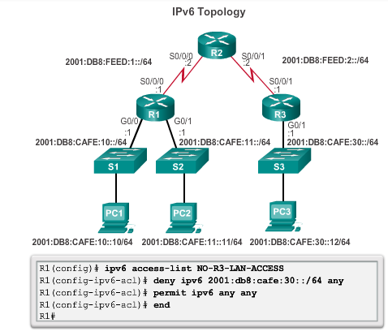
Configuring IPv6 ACLs: Example

Slide 11
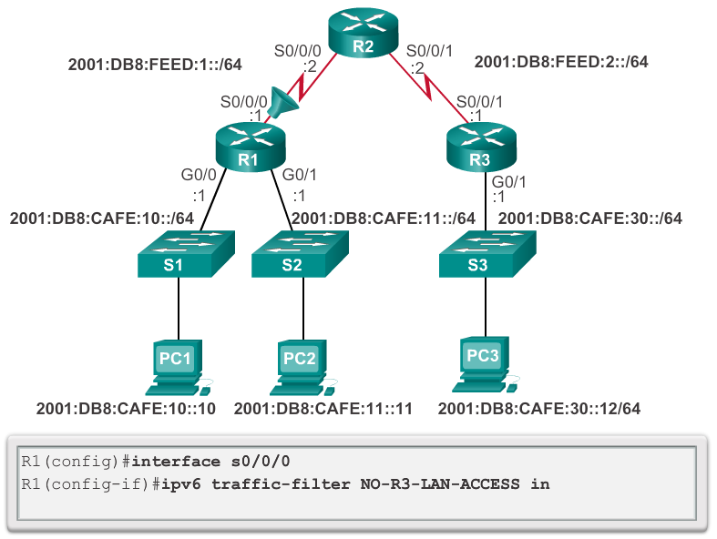
Applying an IPv6 ACL to an Interface
Notes:
9.5.2.3 Applying an IPv6 ACL to an Interface

Slide 12
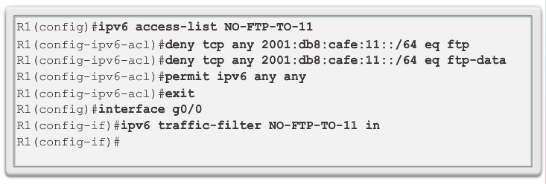
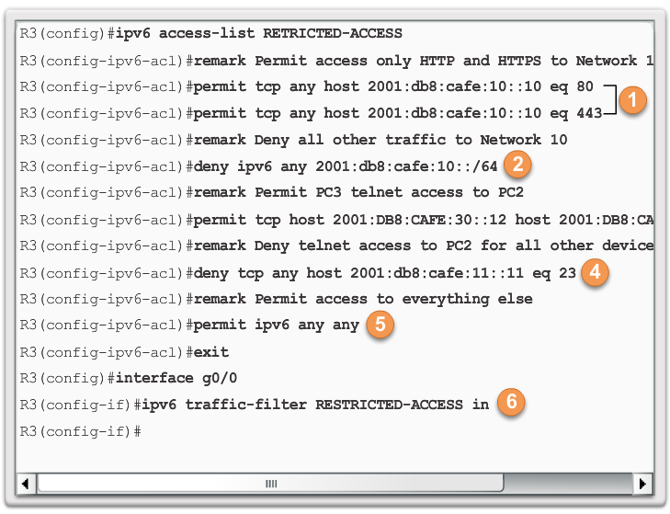
IPv6 ACL Examples
Deny FTP
Restrict Access
Notes:
9.5.2.4 IPv6 ACL Examples

Slide 13
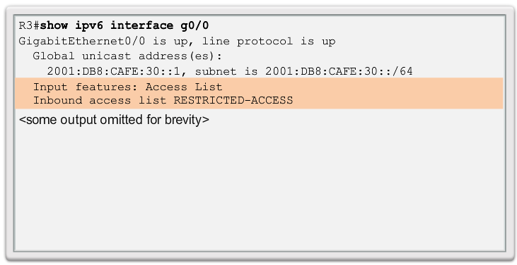
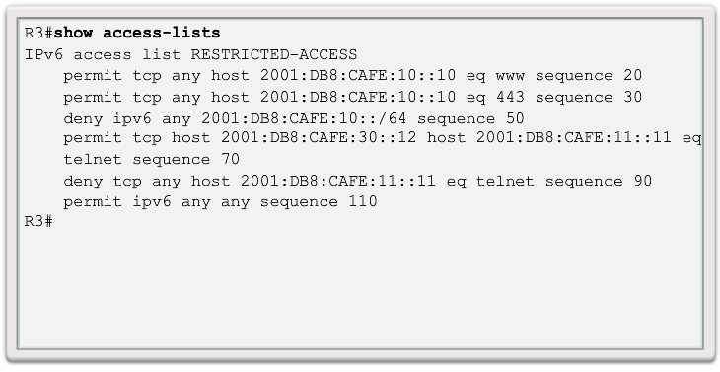
Verifying IPv6 ACLs
Notes:
9.5.2.5 Verifying IPv6 ACLs

